Slide 1
CHAPTER 5
Does doing the dishes have economic value?
  YES
  Consequences (buy new ones, get sick, add to landfills)
  According to Stats. Canada
    YES if you were in a restaurant
    NO if you were at home

Slide 2
GDP: market value of all final goods and services produced in a country in a given period of time
  FLOW variable (time)
  It is a measure of how much stuff wee make
Market value: We use dollars (capture the cost of resources, to add things → there will be a TRANSACTION)
  We look at market transactions to get the market value
All:
Final: Double Counting
Goods and Services:
Produced in a Country: Things produced IN-COUNTRY (not imports)
In a given period of time: Flow → file 2008 tax in 2009 ( it is 2009 GDP)
Notes:
Market value:
→GDP increase, making more stuff, or prices of stuff goes up, or market transactions increase (buying bread, pay for daycare, 50 years ago, it didn’t exist)
Market transactions must be LEGAL (trading crack Is not included in GDP)
Double counting (only count things once):
Add the Added value at each stage of production or we just take the final value (you don’t add each step value of making bread cuz you count wheat every time)
--> Resold items are not part of the GDP

Slide 3
Three ways to calcuate GDP (same concept, different prices)
1) Output (basic prices)
2) expenditure (market prices) → what we spend on output
3) Income (market prices)
Measures income and expenditure at the same time
The difference b/w GDP at market prices and GDP at basic prices is:
  The basic do not inlcude sales tax, market rpices do
Notes:
GDP can be found by adding up all the income

Slide 4
Canada’s 2010 GDP
Equation: Y = C + I + G + NX
Canada’s 2010 GDP is 1.6 trillion
US is 15 trillion (they are 10x Canada’s GDP
Y = 100%
C = 58%
I = 18%
G = 26%
NX = -2%
Canada’s GDP is mainly of: 72% services, 28% goods
Notes:
Y = GDP
(output, expenditure, income)
C = Consumption
Durable goods → item that lasts a long time (appliances) last more than 3 years
Semi-durable → Cloths
Non-durable goods → Big Mac
Services → Getting taxes down, going to dentist
If Jack buys a bottle of Italian wine (IMPORT + CONSUMPTION)
I = investment
Purchase of new capital goods (things we use to make other goods and srevices) M
→ Machinery and equipment (→ sewing machines to make clothes)
New Housing (count as an investment because you have to borrow money to buy it; It lasts a very very long time; more in common in investment goods than consumption goods)
→ The year the house was built, that money gets put into the investment of THAT YEAR.
→ beyond that time, there is an implicit rent (this is included in CONSUMPTION SERVICES!)
-> improvements to a house is an investment
→ Inventory (deals with time; it captures all the goods that are partly through the production or haven’t been sold to consumers yet,
→ in the next year, if consumer buys it for $10, and walmart investment decrease by $9 ($1 contributes to GDP)
G = Government spending
all levels of government, spending on goods and services such as police cars (not transfer payments such as something like canada pension plan, govt transfers you funds but there’s no transaction)
NX = Net exports
purchases of domestically-produced goods of foreigners (exports) MINUS domestic purchases of foreigh goods (imports)
Imports do not affect GDP because the person who buys it increases GDP by X but net export subtracts X for the import and cancels out
GDP dpes not include transactions of items produced in the past such used cars
ARE STOCKS INVESTMENTS?? No not part of GDP
RENTAL service (there is transaction of money) → included in GDP (SERVCE)
OWNER OCCUPIED HOUSING (there is no market transaction) → Stats Canada estimates it and includes it in GDP by implicit rent (SERVICE)

Slide 5
The largest in services-producing industries:
  Wholesale and retail
  Finance, insurance, and real estate
  Health care and social assiatnace
  Transportation and warehousing

Slide 6
Revenue = GDP
Expenditures = GDP
Markets for Goods & Services
G & S sold
G & S bought
Firms
Households
Factors of production
labour, land, capital
Markets for Factors of Production (labour input)
Wages, rent, profit = GDP
Income = GDP
© 2008 Nelson Education Ltd
Notes:
G/S flow from firms to Households
Factor Services flow form households to firm (Households rent labour to firms (you can’t own labour because it’s illegal))
It is a closed system (assume no foreign govt), there is buyer/seller on every side of transaction
Therefore the expenditure dollars must equal the income dollars (the number of dollars in the top half must equal the number of dollars in the bottom half)
GDP:
OUTPUT and EXPENDITURE (counts the dollar at the top of the diagram
INCOME (counts the dollar at the bottom)

Slide 7
Gross National Product (GNP): market value of all final goods and services produced by a country’s factors in a given period of time
  2 factors of production for cars: capital and labour
  Car sells for $30 000 (made in Canada)
  Canadian workers ($10 000)
  The capital is owned by american $20000
Canadian GDP goes up by 30k
  C-GNP goes up by labour input
US GDP unaffected
  US GNP goes up by its capital 20000 (doesn’t take into account to where production takes place, it is who owns the capitals
Notes:
Pick up truck made in Canada (I buy it, it is a consumption)
If a landfill company buys it (it is an investmnent)
If city of hamilton buys that truck (government spending)
If someone in mexico buys that truck (exports)
If canadian workers goes to germany and help produce stuff, Germany GDP increases and so does canada’s GNP.

Slide 8
A wind farm in Manitoba buys a large turbine from Swedish-owned factory located in Ontario and uses local workers
  Canadian investment and GDP increase by the same amount, but Canadian GNP increases by a smaller amount

Slide 9

Measuring Cost of Living
(Chapters 5 and 6)
How do I know if I’m better than my parents were?
GDP if prices or if output or legalize something
real GDP vs. nominal GDP (base year prices vs. current year prices)
GDP deflator: a measure of the price level
Notes:
Comparing prices at different periods of time. There are two different measures of the price level that allow us to calculate inflation rate (how prices change over time) and prices of different time periods.
Since GDP uses the market value of all goods and services, and we’re trying to capture everything in the economy…GDP will rise over time if prices increase or output increases or if both go out.
What to separate the influences of price changing and output changing.
Two types of GDP (measure of output)
Nominal GDP = GDP measured in current prices (prevailing prices) → flatter line
Real GDP = GDP measured in base-year prices (not this year’s prices) → steeper line
GDP deflator = measure of the price level (NOT the same as GDP)
If prices go up over time, but physical output stays the same; GDP increases
If some activities were not market activities become market activities (i.e. legalization of goods/babysit to daycare), GDP also increases.

Slide 10
Example: Canada’s GDP is based on only two goods: skates and hockey pucks. Calculate the GDP with the data below.
 | Skates |  | Hockey pucks
Year
Price
Quantity
Price
Quantity
2006
$50
100
$3
500
2007
$60
200
$4
1000
2008
$70
300
$5
1200
Notes:
To calculate nominal GDP value in the economy = calculate the number of skates sold in a given year x that year’s prices + the number pucks x given price in that year using that year’s price
Do this for each year
Base year of GDP = nominal GDP

Slide 11
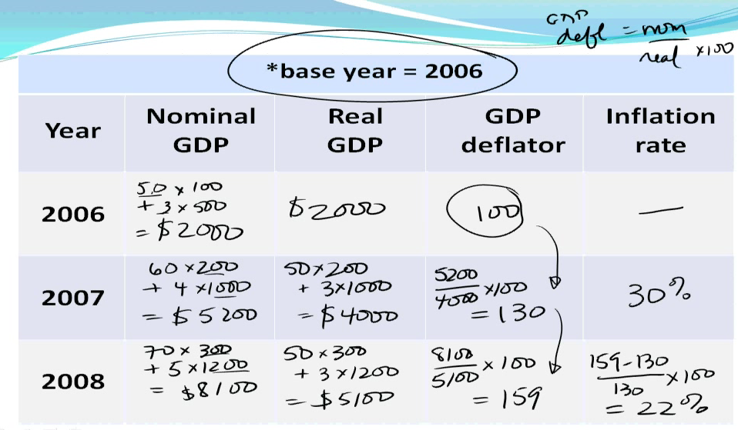
We don’t know the previous year
=6500
=6500
16000/13000 x 100
=123.1
123-100/100 x 100%
=23.1%
=16000
=13000
27000/18600 x100
=145.2
145.2-123.1/123.1 x 100%
=17.9%
=27000
=18600
Notes:
To calculate nominal GDP value in the economy = calculate the number of skates sold in a given year x that year’s prices + the number pucks x given price in that year using that year’s price
Also given base year, calculate real GDP. Look at base-year and calculate output in the current year using the prices from the base year. Real and nominal GDP should be the sapce.
To calculate real GDP, use base-year price x current quantity. → HOLD PRICE CONSTANT ****
→ In the base year, nominal and real GDP are the same
Having nominal and real GDP, can calculate GDP deflator in each year.
Note: GDP deflator is an index. Using it to compare base year to another year. We always make base year = 100 for easier comparison. No units b/c it is an index! GDP deflator is a measure of price level. As we move from year to year, the GDP deflator increases. This shows that general price level increases over time.
Over time the price of skates and pucks go up; this is internally consistent with the GDP deflator as they is increasing over time too.
If individual prices were falling over time, then you would expect the GDP deflator in 2007 to be less than 100 and the GDP deflator in 2008 to be less than 2007.
Base year was 2006. But 2007/2008 could have been the base year! PRACTICE!!! If 2008 was the base year, GDP deflator in 2008 = 100. Since prices are increasing over time, this implies that in 2006/7, GDP deflator would be less than 100.
Calculating the inflation rate.
Inflation rate: rate of change of price from one year to the next
Inflation rate = [(final value – initial value)/initial]x100
Can’t calculate the inflation rate of 2006 b/c we don’t know the GDP deflator value in 2005.
GDP deflator is a made up unit. It is just 100. It is an index that we can compare values against each other.
In 2007 = (130-100)/100 x 100 = 30%
In 2008 = (159-130)/130 x 100 = 22%
> Want from 2007-2008, NOT two year inflation rate since 2006.
Inflation rate is the percent.
P = price level
Use GDP deflator as measure of price level
t = 2007
t – 1 = 2006
If doing an annual inflation rate; annual rate of change in price. no where on this table is there info about 2006
Can’t calculate inflation in the base year. Percent change from GDP deflator 2006 to 2007 = 123.1/100 = 23.1%
145.1 – 123.1/123.1 x 100 = 17.9%
Let’s make 2007 or 2008 the base year. It is more difficult b/c the numbers will be different! GDP deflator in 2007 = 100. GDP in 2006 would be less than 100. GDP in 2008 would be greater than 100.
Rough check on whether or not done properly.
If nominal GDP goes up, the real GDP should go up. If prices are going up over time (GDP deflator goes up because it measures change in price)
Prices of skates and puck went over time. Expect GDP deflator to go up over time if all goods were increasing in price.
Prices were all going down, then inflation rate = - ve = deflation = negative inflation rate.
Negative change in price but can’t have negative price.
Net export can be positive or negative. Not possible for output to be a negative number. – 1 000 000, write a note next to it. GDP is wrong b/c can’t be negative. Try same question but with a different base year.
If base year is 2008. Inflation rate is –ve if prices are falling over time.
IF PRICE AND OUTPUT DECREASE → nominal, real GDP derease, and GDP deflator decrease

Slide 12


How do we calculate inflation using CPI?
Consumer Price Index (CPI): measures overall cost of goods for a typical urban household
it is a measure of the price level
steps to calculating inflation using CPI
1. Fix the basket
2.
3.
X 100
X 100
Notes:
Chapter 6.
Typical urban household is impt b/c there is a difference b/w goods included in CPI and goods in GDP deflator.
If you live in a rural household, you may not buy the same type of goods as an urban household. The CPI may not reflect the impact of changing price for the rural household.
If you’re a senior citizen, CPI may not reflect as well b/c they spend a lot on pharmaceutical drugs so if those prices are rising faster than the other goods in the economy, then CPI may not capture impact of rising prices on them.
Like GDP deflator, CPI is a measure of the price level. The difference is with CPI we’re talking about a basket of goods purchased by a typical urban household, the quantities of goods stay fixed and we look at what is happening to prices over time.
How to calculate CPI:
Fix the basket of goods. What are the goods that typical households purchase? (i.e. 4L of milk/week? 95L of gas? 3 Macdonalds?
Then go out and collect data on the prices of the goods (this is done by the government). Once have prices…
CPI = cost of the basket in current year/cost of the basket in base year x 100
To calculate inflation rate, method is the same as GDP deflator
Inflation rate = [(P(t) – P(t-1))/P(t-1)] x 100→ price level in period t – price level in period t-1 (i.e. if t = 2008; t-1 = 2007)

Slide 13
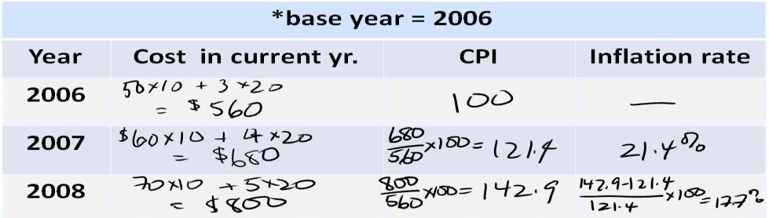
Example: basket = 10 skates and 20 hockey pucks
Year | Price of skates | Price of hockey pucks
2006 | $50 | $3
2007 | $60 | $4
2008 | $70 | $5
Notes:
In 2006, how much does 10 skates and 20 pucks cost? SEE CALCULATIONS ABOVE.
CPI in base year also 100. There are no units.
i.e. in 2007, 680/560 x 100 = 121.4
i.e. in 2008, 800/560 x 100 = 142.9
Inflation rate for 2005 is unavailable, so inflation rate for 2006 is not applicable.
Inflation rate in 2007 = 121.4-100/100 x 100 = 21.4%
Inflation rate in 2008 = 142.9-121.4/121.4 x 100 = 17.7%
Try using quantities in base year for GDP deflator exercise! (100 skates and 500 pucks). Even though use same raw data, measure of price level and inflation rates may be different b/c when using GDP calculations we’re holding prices fixed and allowing quantities to change. When using CPI, we’re holding quantities fixed and allowing prices to change.
Try using different years too!
-----------------------------------------
Inflation rate calculation with CPI = Inflation rate calculation with GDP deflator.
Type of question:
Nominal GDP, Real GDP
Bottom table, use Q from base year as fixed Q as your basket of goods. Holding Q fixed, allowing P to change OR holding P fixed, allowing Q to change.

Slide 14
Using CPI
Your father earned $40,000 in 1982. What is this salary worth in 2010 dollars?
CPI(1982) = 61.8
CPI (2010) = 116.3
116.3/61.8 = x / 40 000
x = $$75, 275

Slide 15
3 Problems with CPI
Problems (make inflation seem worse than it actually is)
  1. Subsitution bias – ignores consumers substiution; overstates inflation
    Price of juice goes up, (CPI assumes ppl still buy the same amount of juice even though people would actually buy less)
  2. Introduction of new goods – CPI is based on a fix basket of goods and services; overstates inflations
    Introduction of new goods is much faster (price drops very fast → this would cause downward pressure on CPI)
  3. Unmeasured quality change – some price of changes reflect quality imporvements; overstates inflation
    Car price gone up over the years (think of car as a collection of features) → not just because dollars are going up but because the quality goes up
Notes:
1 pulls actual CPI it up, 2 pulls it down so they cancel out
GDP → does not account for economic bad or depletion of resources, non-market productino (wash own car), enjoyment, intensive use of resources

Slide 16
For some racquet sports there have been increases in the size of the racquest and the methods and materials used for making them make them have improved. What problem in the construction of the CPI is this most relevant
Unmeasured quality change

Slide 17
Index
Pension or wages is INDEXED (related) to inflation
  Dollar auto-corrected for effects of inflation
Indexing were introduced due to increase in life expectancy (if pension was fixed, our pension in 1982 will still be the same in 2010)
Pensions come out of our tax dollars
Senior citizens don’t buy the same things as a normal household (different CPI) → CPI is overstated for seniors

Slide 18
CPI vs GDP deflator
1. CPI – goods and services bought by typical consumers
GDP deflator – reflects prices of all gods and service produced domestically
2. CPI – prices change, quantities stay fixed (basket)
GDP deflator - quantities change, prices stay fixed (use
base year prices)
QUESTION: Suppose price of bananas goes up
  CPI increase, GDP no change
  We need to know (do we grow bananas in Canada?) → NO, therefore GDP unaffected
  We need to know whther a typical household consume bananas? If so, CPI is affected

Slide 19
A German car company makes cars in Canada, some are exported. If the price of the cars increases, the GDP deflator will:
A) and CPI both increase
B) increase and CPI unchanged
C) unchanged and CPI increase
D) and CPI both unchanged
If it was a police car (gov’t) or rental car (invest), no change in CPI
Notes:
Problem, not everyone buys a new car every year, but there is a considerable consumption on cars
Think of the car of $35000 that last you 5 years, so you technically spend $7500 a year

Slide 20
Interest rates
Ex: You have decided not to buy a pair of shoes that cost $100 and instead put the $100 into a savings account earnig 5% interest per year. How many dollars do you have after 1 year.
Ans: P = C(1+n)^t
I=Prt

Slide 21
If all prices in economy increased by 3% during the year, how much does the pair of shoes now cost?
$103
What if the prices in ecnoomy increased by 10% during the year?
110

Slide 22
Nominal interest rate: Interest rate WITHOUT correction for inflation – meausres the increase in the number of dollars in your bank account (we see in our economy today)
Real interest rate: interest rate WITH correction for inflation – measures the increase in the purchasing power of the dollars in your savings account
Real interest rate = nom. Interest rate – inflation rate
If inflation is greater than interest rate, your purchasing power is going down

